Slide 1
The five critical differences between SQL and NoSQL are:
NoSQL databases | SQL databases
are non-relational. | are relational
have dynamic schemas for unstructured data | use structured query language (SQL) and have a predefined schema
are horizontally scalable | are vertically scalable
are document, key-value, graph, or wide-column stores | are table-based
is better for unstructured data like documents or JSON | are better for multi-row transactions

Slide 2

What is NoSQL?
NoSQL stands for Not only SQL. It is a type of database that uses non-relational data structures, such as documents, graph databases, and key-value stores to store and retrieve data. NoSQL systems are designed to be more flexible than traditional relational databases and can scale up or down easily to accommodate changes in usage or load. This makes them ideal for use in applications.
Examples: MongoDB, Cassandra, Couchbase, Amazon DynamoDB
MongoDB is an open-source, cross-platform, document-oriented, and non-relational database system.
Main features of MongoDB
High Performance
Flexibility
Availability
Scalability

Slide 3
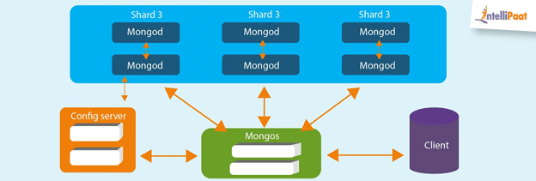
Features of MongoDB

Slide 4
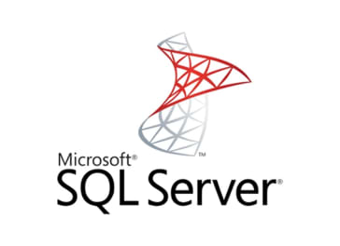
What is SQL?
SQL is a domain-specific language used to query and manage data. It works by allowing users to query, insert, delete, and update records in relational databases. SQL also allows for complex logic to be applied through the use of transactions and embedded procedures such as stored functions or views.
Examples: MySQL, PostgreSQL, Oracle, SQL Server
SQL Server is a Relational Database Management System(RDBMS). It is also known as Microsoft SQL Server or sometimes as MSSQL.
Cloud Database Support
Ease of Management
High Security
End-to-End Business Data
Solutions

Slide 5
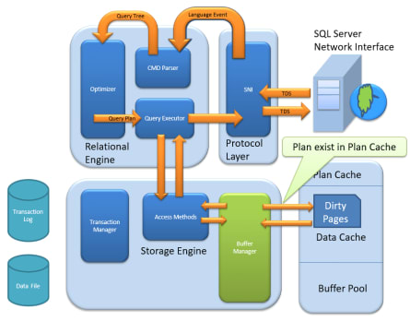
Features of SQL Server

